Slide 1
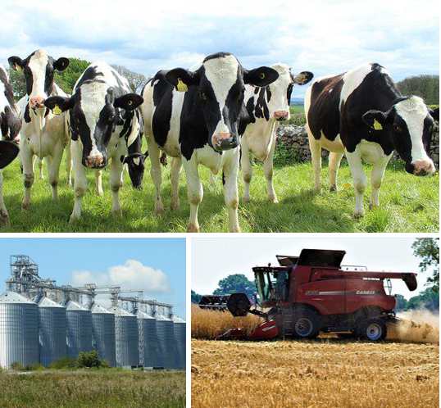
Statewide Program of Study: Agriculture Business, Leadership, and Communications — Page 1
Revised–May 2024
Agriculture, Food, and Natural Resources Career Cluster
The Agriculture, Food, and Natural Resources (AFNR) career cluster focuses on the essential elements of life, food, water, land, and air. This career cluster includes occupations ranging from farmer, rancher, and veterinarian to geologist, land conservationist, and florist.
Statewide Program of Study: Agriculture Business, Leadership, and Communications
The Agriculture Business, Leadership, and Communications program of study focuses on occupational and educational opportunities associated with farming and agriculturally related businesses that supply farm inputs, such as machinery and seeds. This program of study includes exploration of farm product marketing, the purchase of farm products either for processing or resale, and the process of grading or classifying unprocessed food or other agricultural products.
Secondary Courses for High School Credit
Level 1 | Principles of Agriculture, Food, and Natural Resources
Level 2 | Entrepreneurship I Entrepreneurship I DC *Navarro
Level 3 | Agribusiness Management and Marketing *Agribusiness Management and Marketing DC *Tarleton
Level 4 | Practicum in Agriculture, Food, and Natural Resources Practicum of Entrepreneurship DC
Example Postsecondary Opportunities
Associate Degrees
Accounting
Agribusiness
Bachelor’s Degrees
Agriculture Economics
Agribusiness
Master’s, Doctoral, and Professional Degrees
Accounting
Applied Economics
Additional Stackable IBCs/License
Accredited Farm Manager
Aligned Advanced Academic Courses
AP or IB | AP Microeconomics AP Statistics IB Economics SL IB Economics HL IB Mathematics Analysis and Approaches SL IB Mathematics Analysis and Approaches HL
Dual Credit | Dual credit offerings will vary by local educational agency.
Example Aligned Occupations
Loan Interviewers and Clerks
Median Wage: $46,572
Annual Openings: 2,307
10-Year Growth: 10%
Students should be advised to consider these course opportunities to enrich their preparation. AP or IB courses not listed under the Secondary Courses for High School Credit section of this framework document do not count towards concentrator/completer status for this program of study.
Work-Based Learning and Expanded Learning Opportunities
Loan Officers
Median Wage: $66,285
Annual Openings: 2,261
10-Year Growth: 14%
Work-Based Learning Activities | Shadow at a farm or ranch that manages livestock and crops to learn about processing and sales Intern at an agrochemical manufacturer to learn about new technologies in agribusiness
Expanded Learning Opportunities | Participate in an FFA career, leadership, and speaking contest like an agriscience fair Attend an agricultural industry seminar
Agriculture Business, Leadership, and Communications
Farmers, Ranchers, and Other Agricultural Managers
Median Wage: $65,490
Annual Openings: 28,020
10-Year Growth: 4%
Aligned Industry-Based Certifications
Entrepreneurship and Small Business
Production Agriculture - Job Ready
Microsoft Office Specialist: Microsoft Excel Expert (Excel 2019)
Data Source: TexasWages, Texas Workforce Commission. Retrieved 3/8/2024
.
Successful completion of the Agriculture Business, Leadership, and Communications program of study will fulfill requirements of the Business and Industry endorsement.
For more information visit: https://tea.texas.gov/academics/college-career-and-military-prep/career-and-technical-education/programs-of-study-additional-resources

Slide 2
Statewide Program of Study: Agriculture Business, Leadership, and Communications — Page 2
Agriculture, Food, and Natural Resources Career Cluster
Statewide Program of Study: Agriculture Business, Leadership, and Communications
Course Information
Course |  | Prerequisites | Corequisites | Career Clusters
Principles of Agriculture, Food, and Natural Resources* 13000200 (1 credit) |  | Prerequisites: None Corequisites: None Recommended Prerequisites: None Recommended Corequisites: None | 1. Agriculture, Food and Natural Resources
Level 1
Course |  | Prerequisites | Corequisites | Career Clusters
Entrepreneurship I* 13011101 (1 credit) |  | Prerequisites: None Corequisites: None Recommended Prerequisites: Principles of Business, Marketing and Finance Recommended Corequisites: None
Level 2
Course |  | Prerequisites | Corequisites | Career Clusters
Agribusiness Management and Marketing 13000900 (1 credit) |  | Prerequisites: None Corequisites: None Recommended Prerequisites: None Recommended Corequisites: None | 1. Agriculture, Food and Natural Resources
Level 3
Course |  | Prerequisites | Corequisites | Career Clusters
Practicum in Agriculture, Food, and Natural Resources* First Time Taken: 13002500 (2 credits) Second Time Taken: 13002510 (2 credits) |  | Prerequisites: None Corequisites: None Recommended Prerequisites: A minimum of one credit from the courses in the AFNR career cluster Recommended Corequisites: None | 1. Agriculture, Food and Natural Resources
Practicum in Entrepreneurship* First Time Taken: 13011111 (2 credits) |  | Prerequisites: None Corequisites: None Recommended Prerequisites: Entrepreneurship I and II or successful completion of at least two courses in a CTE program of study Recommended Corequisites: None | 1. Agriculture, Food and Natural Resources 2. Architecture and Construction 3. Arts, Audio Visual Technology and Communication 4. Business, Marketing, and Finance 5. Health Science 6. Hospitality and Tourism 7. Human Services 8. Information Technology 9. Manufacturing 10. Transportation, Distribution and Logistics
Agriculture Business, Leadership, and Communications
* Indicates course is included in more than one program of study.
For additional information on the Agriculture, Food, and Natural Resources career cluster,
contact cte@tea.texas.gov or visit https://tea.texas.gov/cte
[LEA name] does not discriminate on the basis of race, color, national origin, sex, or disability in its programs or activities and provides equal access to the Boy Scouts and other designated youth groups. The following person has been designated to handle inquiries regarding the nondiscrimination policies: [title], [address], [telephone number], [email]. Further nondiscrimination information can be found at Notification of Nondiscrimination in Career and Technical Education Programs.

